Slide 1


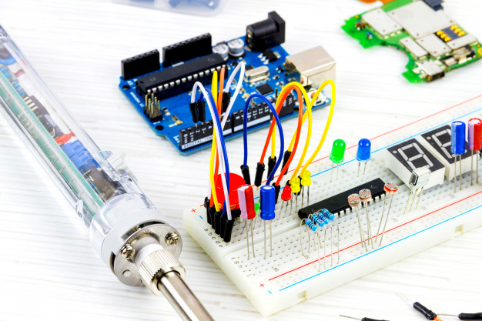
Andhra Pradesh State Skill Development Corporation
ARDUINO UNO
By,
B Nagaraju – APSSDC,
Technical Skill Trainer,
Phone no: +91-8463961431,
Mail id: Nagaraju.b@apssdc.in

Slide 2

What is Arduino?

Slide 3
Arduino is an open-source electronics platform based on easy-to-use hardware and software.
Arduino boards are able to read inputs - light on a sensor, a finger on a button, or a Twitter message - and turn it into an output - activating a motor, turning on an LED, publishing something online.
You can tell your board what to do by sending a set of instructions to the microcontroller on the board.
Arduino was born In 2005 at the Ivrea Interaction Design Institute as an easy tool for fast prototyping.

Slide 4

Why Arduino?

Slide 5
Arduino has been used in thousands of different projects and applications.
Arduino is a key tool to learn new things. Anyone - children, hobbyists, artists, programmers
Inexpensive - Arduino boards are relatively inexpensive compared to other microcontroller platforms.
Cross-platform - The Arduino Software (IDE) runs on Windows, Macintosh OSX, and Linux operating systems. Most microcontroller systems are limited to Windows.
Simple, clear programming environment - The Arduino Software (IDE) is easy-to-use for beginners
Open source and extensible software - The Arduino software is published as open source tools, available for extension by experienced programmers.
Open source and extensible hardware.

Slide 6
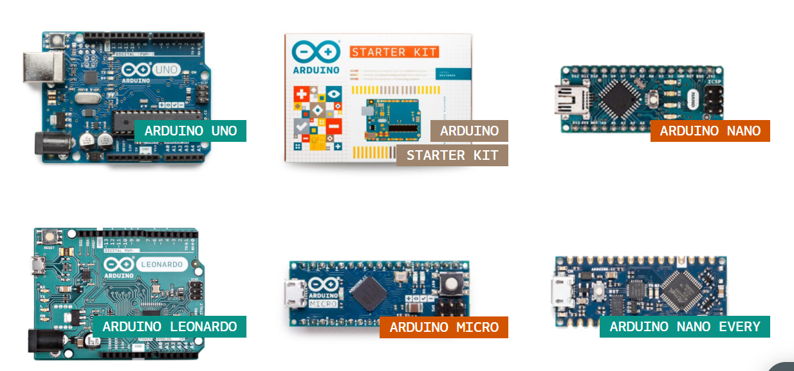
Arduino Products or Types
Entry Level

Slide 7
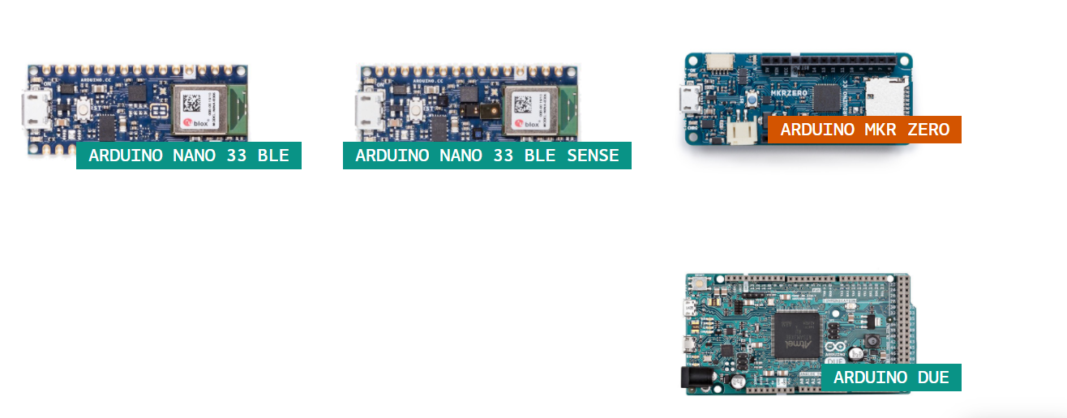
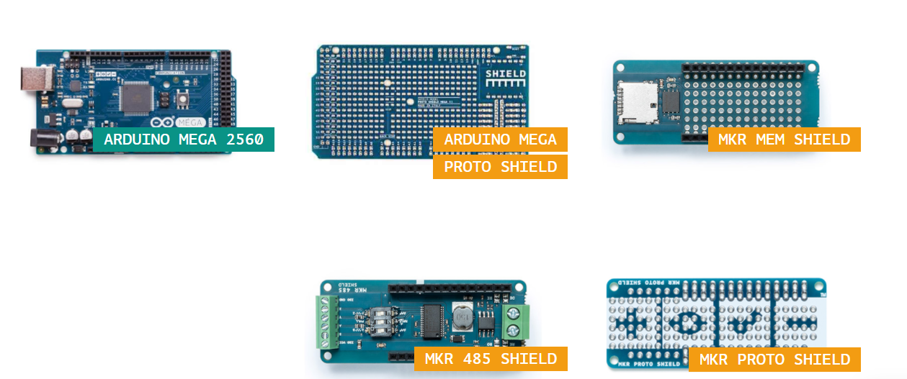
Enhanced Features

Slide 8
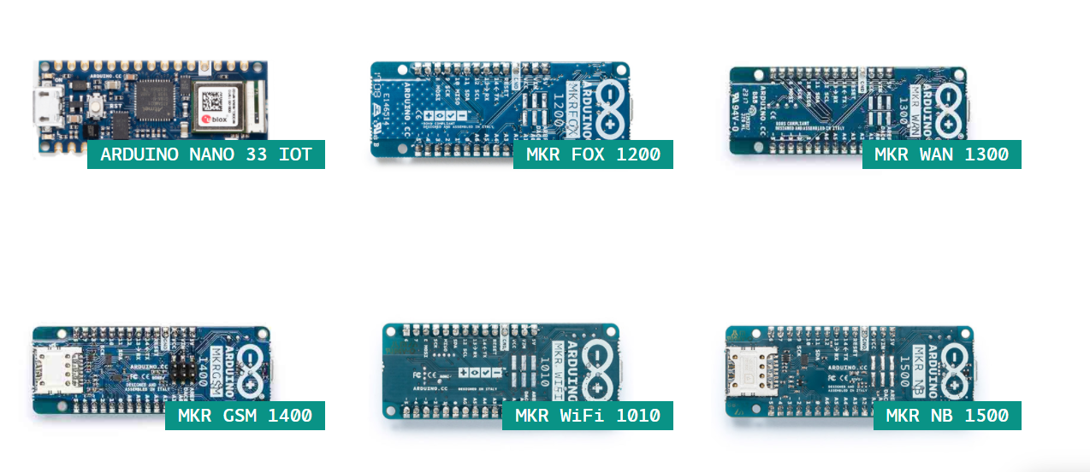
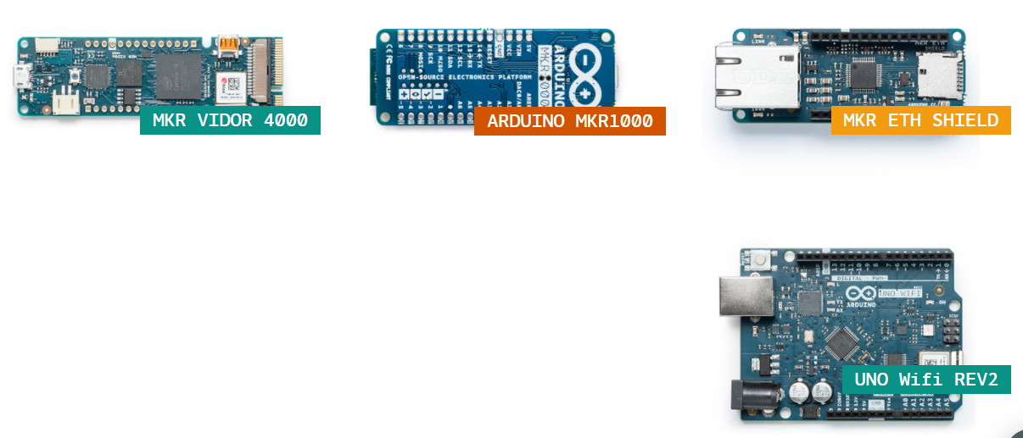
Internet of Things

Slide 9
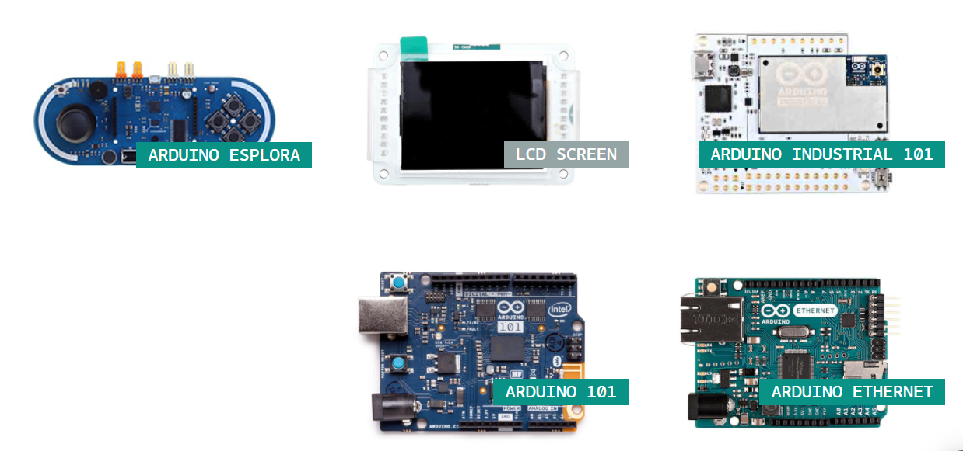
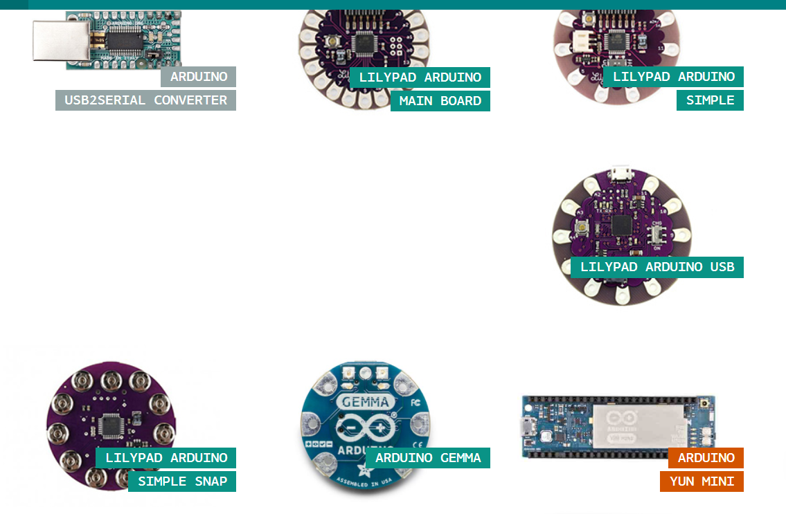
Retired

Slide 10
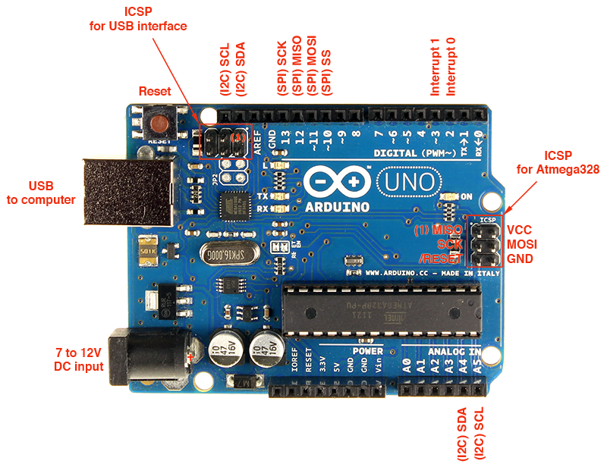
ARDUINO UNO

Slide 11
Arduino Uno is a microcontroller board based on the ATmega328P
It has 14 digital input/output pins (of which 6 can be used as PWM outputs), 6 analog inputs
a 16 MHz ceramic resonator (CSTCE16M0V53-R0)
a USB connection, a power jack, an ICSP header and a reset button.
simply connect it to a computer with a USB cable or power it with a AC-to-DC adapter or battery to get started
"Uno" means one in Italian

Slide 12
Technical Specification
Microcontroller : ATmega328P
Operating Voltage 5V
Input Voltage (recommended) 7-12V
Input Voltage (limit) 6-20V
Digital I/O Pins 14 (of which 6 provide PWM output)
PWM Digital I/O Pins 6
Analog Input Pins 6
DC Current per I/O Pin 20 mA
DC Current for 3.3V Pin 50 mA
Flash Memory 32 KB (ATmega328P) of which 0.5 KB used by bootloader
SRAM 2 KB (ATmega328P)
EEPROM 1 KB (ATmega328P)
Clock Speed 16 MHz
LED_BUILTIN 13
Weight 25 g

Slide 13
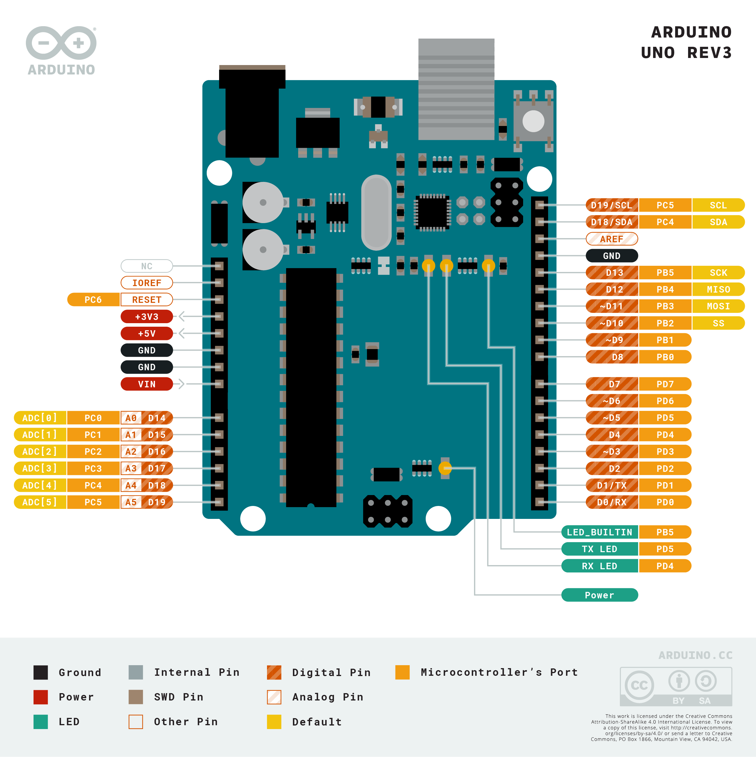
Pin Out:

Slide 14
How do I use Arduino?
BEFORE YOU START CONTROLLING YOU NEED TO SET UP THE SOFTWARE TO PROGRAM YOUR BOARD
The Arduino Software (IDE) allows you to write programs and upload them to your board. In the Arduino Software page you will find two options:
If you have a reliable Internet connection, you should use the online IDE (Arduino Web Editor). It will allow you to save your sketches in the cloud
If you would rather work offline, you should use the latest version of the desktop IDE.

Slide 15
Install the Arduino Desktop IDE

Slide 16
accordingly to your operating system.
Windows
Mac OS X
Linux
Portable IDE (Windows and Linux)
ChromeOS (Arduino Create Chrome App) for Individuals and for Education

Slide 17
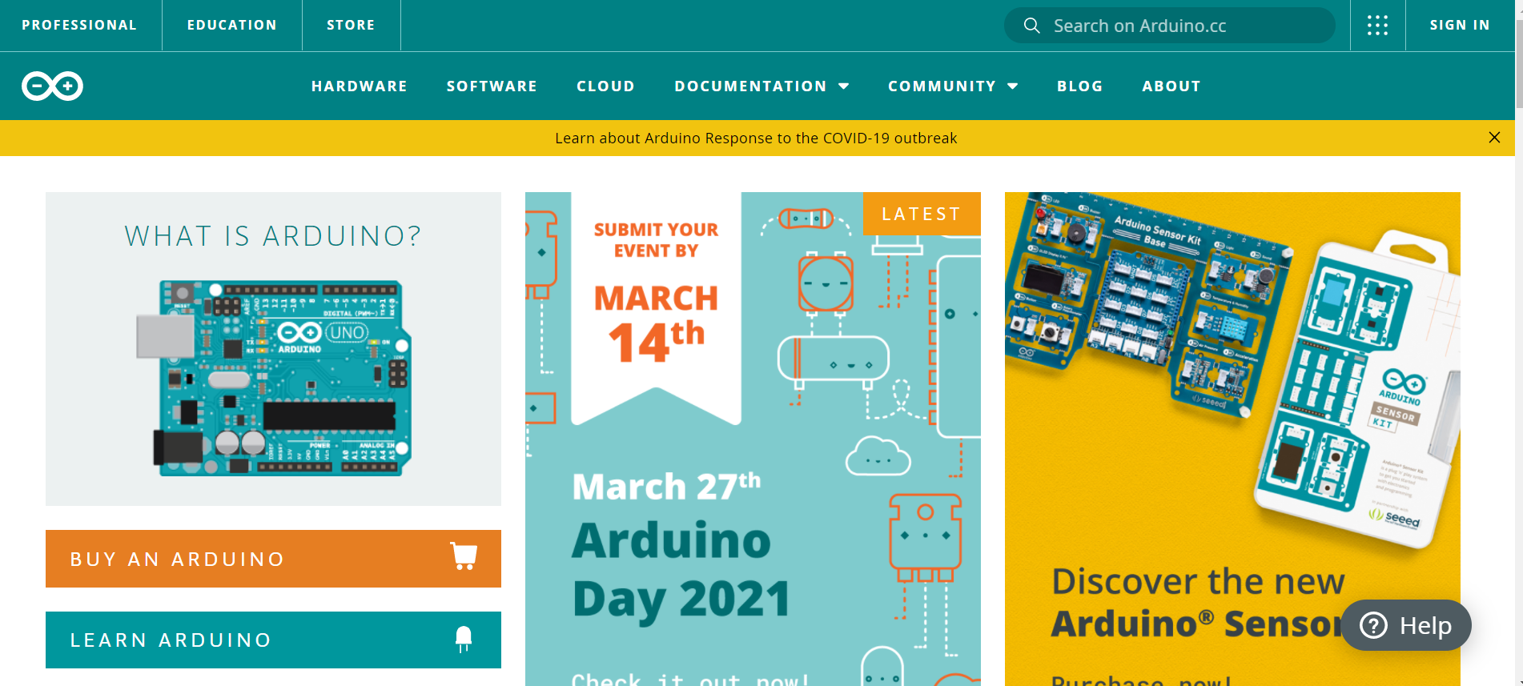
Install the Arduino Software (IDE) on Windows PCs
Get the latest version from the Arduino.cc web site

Slide 18
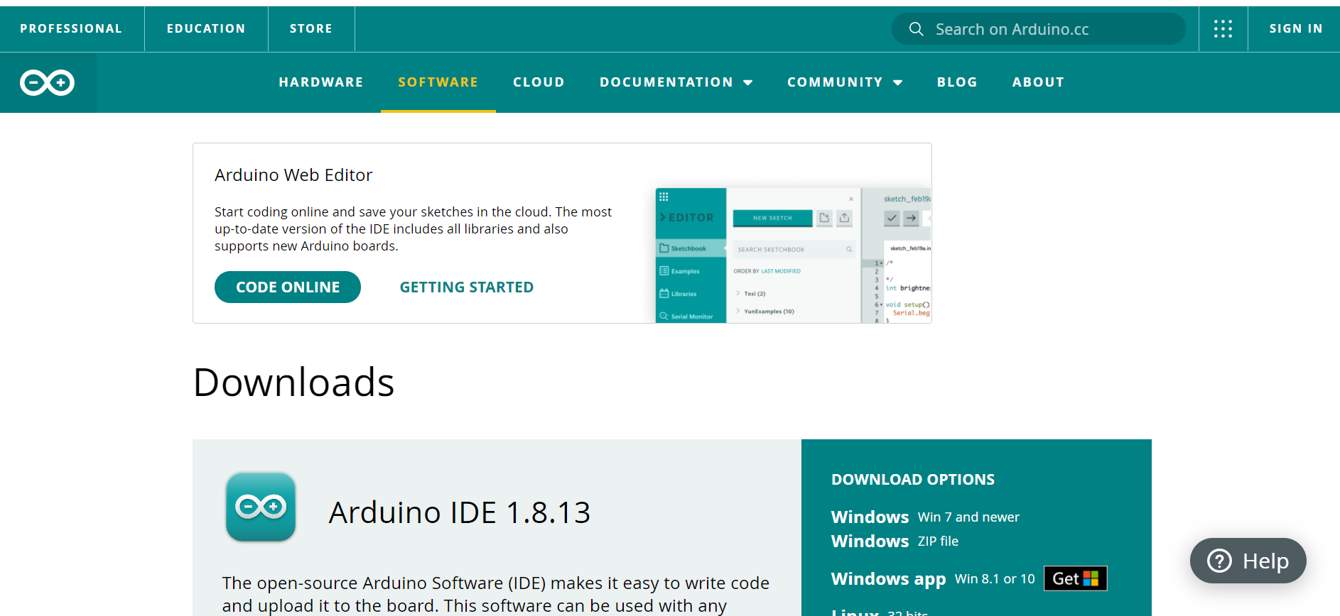
Select on software option

Slide 19
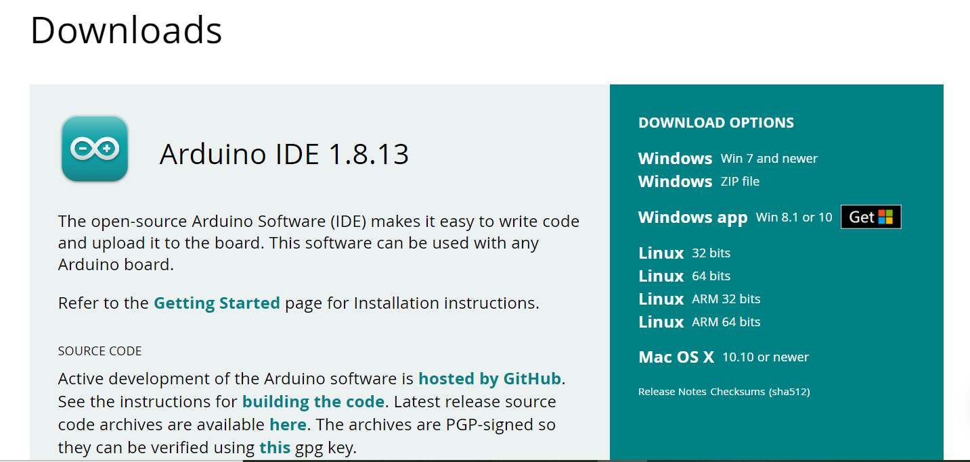
Select latest version of IDE and OS

Slide 20
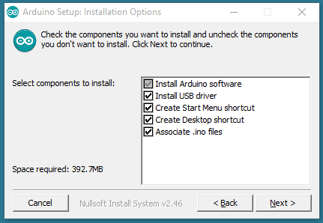
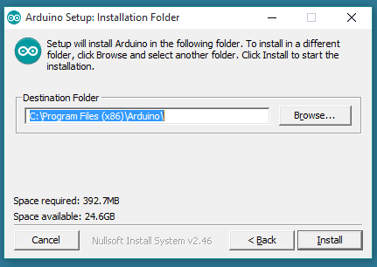
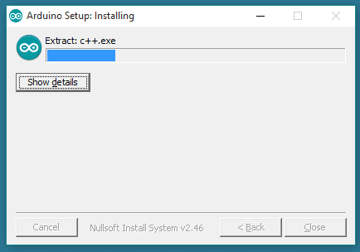
When the download finishes, proceed with the installation
The process will extract and install all the required files to execute properly the Arduino Software (IDE)

Slide 21
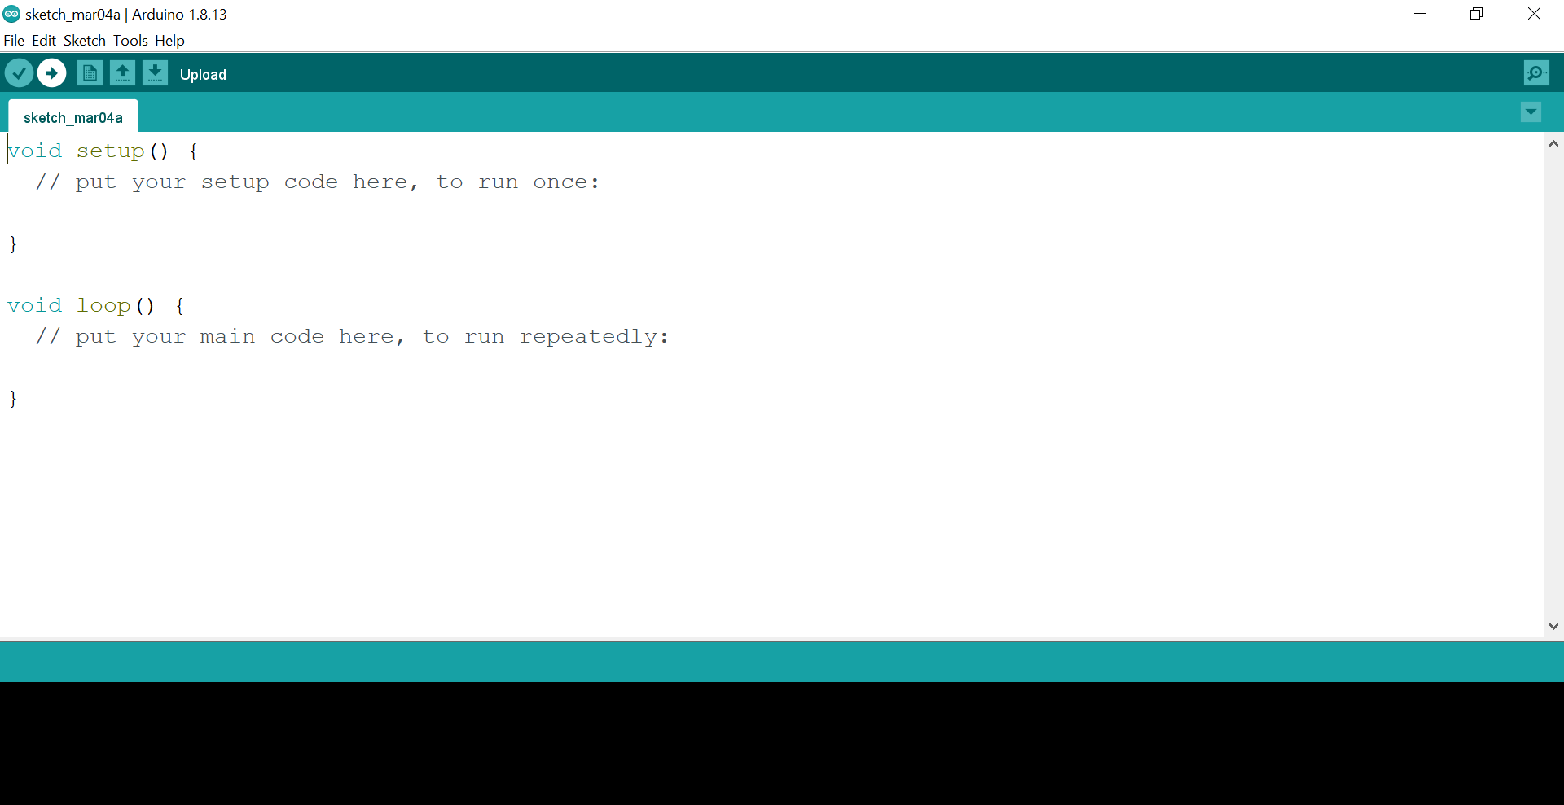
Arduino Software (IDE)

Slide 22
The Arduino Integrated Development Environment - or Arduino Software (IDE) - contains a text editor for writing code, a message area.
A toolbar with buttons for common functions and a series of menus.
Programs written using Arduino Software (IDE) are called sketches.
These sketches are written in the text editor and are saved with the file extension .ino.
The message area gives feedback while saving and exporting and also displays errors.
The bottom righthand corner of the window displays the configured board and serial port.
The toolbar buttons allow you to verify and upload programs, create, open, and save sketches, and open the serial monitor.

Slide 23
Writing Sketches:
Verify Checks your code for errors compiling it.
Upload Compiles your code and uploads it to the configured board. See uploading below for details.
New Creates a new sketch.
Open Presents a menu of all the sketches in your sketchbook. Clicking one will open it within the current window overwriting its content.
Save Saves your sketch.
Serial Monitor Opens the serial monitor.

Slide 24
HOW TO WRITE PROGRAMMING/SKETCH IN ARDUINO IDE

Slide 25
Comments
/* Blink http://www.arduino.cc/en/Tutorial/Blink */
Everything between the /* and */ is ignored by the Arduino when it runs the sketch
Or
//Sample Blink program
There's another style for short, single-line comments. These start with // and continue to the end of the line. For example, in the line:
int ledPin = 13; // LED connected to digital pin 13

Slide 26
Arduino Sketch: Structure and Flow
Arduino sketch is the name that Arduino uses for a program. It’s the unit of code that is uploaded to, and run on an Arduino board. A basic Arduino sketch consists of two functions:
setup()
Statements in the setup() function are executed only once when the sketch is run
loop()
Statements in the loop() function will run continuously from top to bottom and then back to the top.

Slide 27
Arduino IDE: Variables
Defining a Variable
Variable_Datatype Varible_Name;
Variable_Datatype can be int or float depending on the type of variable you want.
Variable_Name is the name of variable. Variable is referenced or used by its name later in the program.
Ex: int count;

Slide 28
How to name a Variable
Variables can consist of both uppercase (A-Z) and lowercase(a-z) letters.
Variables can contain numbers 0 to 9, but cannot start with a number.
Variables may not have the same names as Arduino language keywords, e.g. you cannot have a variable named float.
Variables must have unique names, i.e. you cannot have two variables with the same name.
Variable names are case sensitive, so Count and count are two different variables.
Variables may not contain any special characters, except the underscore (_).

Slide 29
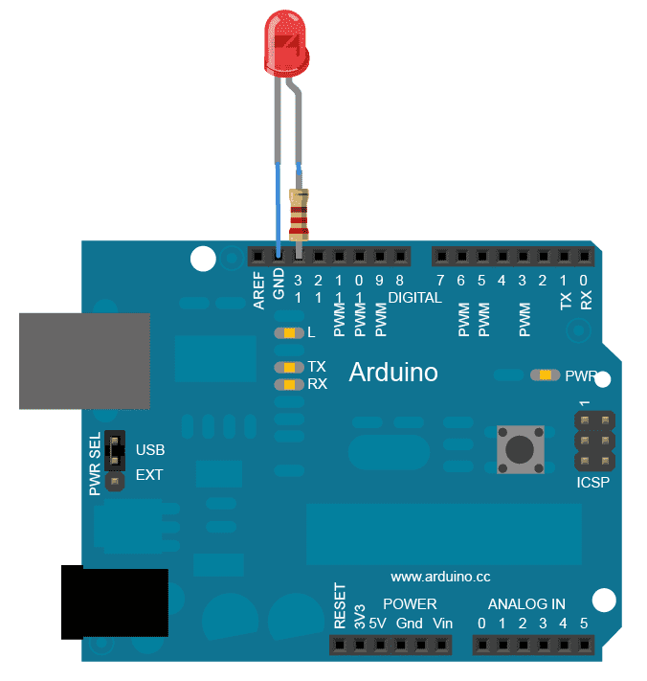
Basic LED Blink Program.
Int led=13;
setup()
{
pinMode(led, OUTPUT);
}
loop()
{
digitalWrite(led, HIGH);
delay(1000); // wait for a second
digitalWrite(led, LOW);
delay(1000); // wait for a second
}

Slide 30


